Slide 2

CREATING EFFECTIVE WORSHIP

Slide 3

What is worship?

Slide 4

Worship is an encounter with God. Worship is submission to the power of God.

Slide 5
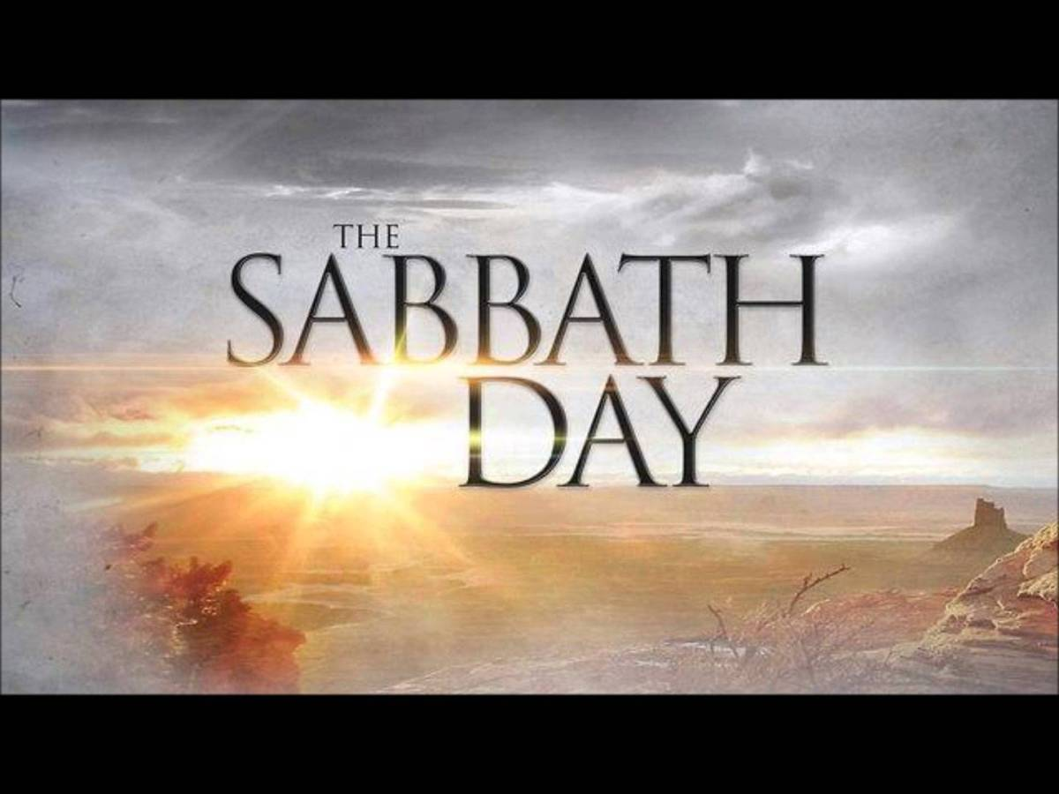
Ezekiel 20:12 “Moreover I also gave them My Sabbaths, to be a sign between them and Me, that they might know that I am the Lord who sanctifies them.”

Slide 6
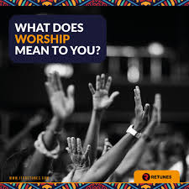

Slide 7
For Ellen White the meaning of true worship today should be marked by a biblical simplicity and some basic biblical principles.
First, God alone should be the object of worship (Exodus 20:3-5; Spiritual Gifts, vol. 3, p. 269). In a world in which not only idols of wood and stone are worshiped, but in which human accomplishments, pride, and money are made gods, we are reminded that we are to “worship and serve the Lord God, and Him only. [...] Anything that is made the subject of undue thought and admiration, absorbing the mind, is a god chosen before the Lord” (Sons and Daughters of God, p. 56; see also Evangelism, p. 133).

Slide 8








Slide 9
second biblical principle underlines the futility of exterior forms of worship deprived of biblical meaning and foundation (Exodus 20:4-6, 23). Today, many are tempted to look upon “outward forms” and ceremonies as sufficient indicators of true worship (Ye Shall Receive Power, p. 48). For Ellen White, however, such “cannot be substituted for inward piety” and obedience to Christ (BE, June 1, 1887).

Slide 10

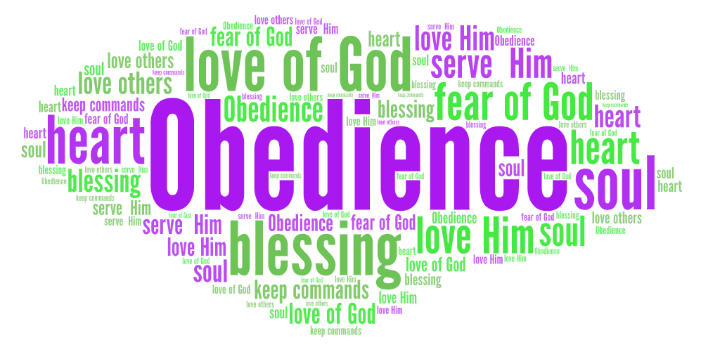

Slide 11
Jesus explained that the spiritual renewal occasioned by the new birth experience is essential in true worship (John 3:5- 8; DA 189). True worship is thus the fruit of the work of the Holy Spirit upon a person’s life; it is the result of conversion and inspired by a “true knowledge of Jesus Christ” (John 17:3; Medical Ministry, p. 112).

Slide 12
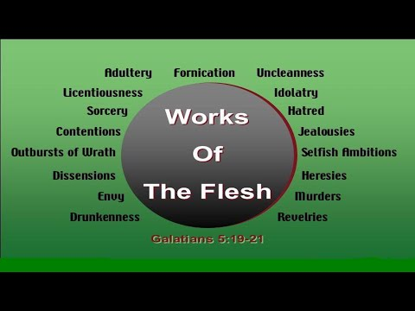


Slide 13
A fourth biblical principle highlights the close relationship between worship and obedience to God’s will. Genuine worship cannot be separated from a genuine Christian life. “True worship consists in working together with Christ” (Matthew 25:34-40; James 1:27; RH, August 16, 1881).

Slide 14
Ellen White’s foremost concern which shaped her counsels on worship was to help Christians be ready to “appreciate a pure and holy heaven, and be prepared to join with the worshipers in the heavenly courts above, where all is purity and perfection, where every being has perfect reverence for God and His holiness” (5T 500).

Slide 15
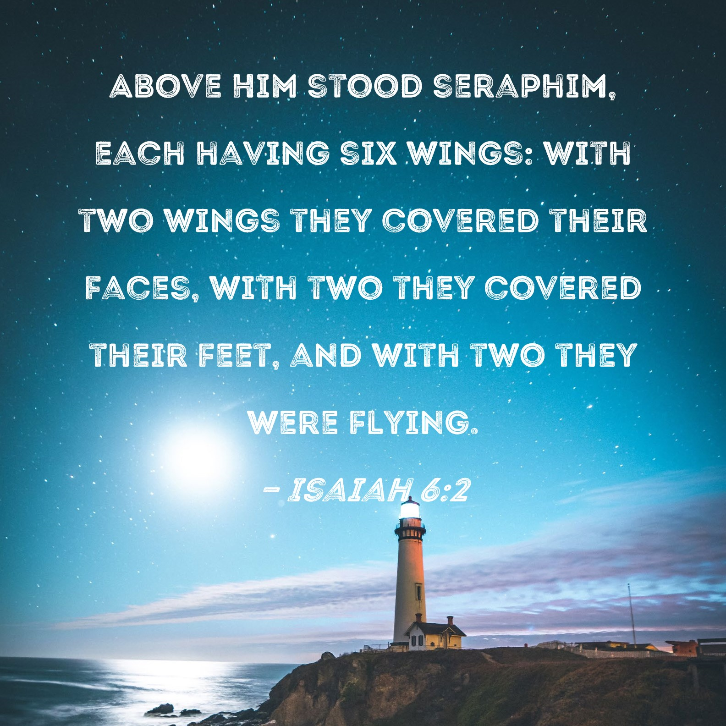

Slide 16
Worship produces changes in us.
Makes us aware of our personal need, Strengthens our faith
Provides spiritual power

Slide 17
Worship includes:
God’s Word,
prayer
praise
Music
bringing back
devotional inspiration
emotional response of commitment.

Slide 18

“Prayer is the opening of the heart to God as to a friend. Not that it is necessary in order to make known to God what we are, but in order to enable us to receive Him. Prayer does not bring God down to us, but brings us up to Him.” (Steps to Christ, 93).

Slide 19
PRINCIPLES OF MUSIC IN CHRISTIAN WORSHIP
Worship music should reflect both God’s exalted character (His transcendence) and His gracious closeness to humankind (His immanence). Its expression is to avoid the fallen secular, selfish, and sensual.
2 Worship music should serve faithfully the teaching of God’s Word. It should have a clear witness to Scriptural doctrine avoiding false theology.
3. Issues in worship music are informed by essential, yet general, contexts from Scripture.
4. Worship music communicates generally-understood meaning that makes it appropriate or inappropriate for worship.
5. The message’s meaning includes musical style, presentation, and instrumentation.
These are essential parts of the meaning, not neutral. Godly discernment identifies fallen secular elements in musical style, presentation, and instrumentation around us. This discernment must help us to know what musical elements to avoid using in worshiping the holy God. e.
6. Worship music ultimately should proclaim God’s good news

Slide 20
Youth need to experience profound, time-honored worship expressions in edifying ways, along with fresh expressions originating in our time. Worship music of heritage traditions and of contemporary expressions should be chosen using Scripture as their consistent standard. In worship-music choices, deferring to one another in love is essential for upbuilding the church as Christ’s body while maintaining faithful witness to God. Worship music choices should exemplify the wholesome best that is reasonable and possible in a given worship context. The experience of worship music should involve active participation by many.

Slide 21
THE SABBATH
Make the Sabbath a Delight—”All who love God should do what they can to make the Sabbath a delight, holy and honorable. They cannot do this by seeking their own pleasure in sinful, forbidden amusements. Yet they can do much to exalt the Sabbath in their families and make it the most interesting day of the week. We should devote time to interesting our children. A change will have a happy influence upon them. We can walk out with them in the open air; we can sit with them in the groves and in the bright sunshine, and give their restless minds something to feed upon by conversing with them upon the works of God, and can inspire them with love and reverence by calling their attention to the beautiful objects in nature.” (Child Guidance 536.1).

Slide 22

PERSONAL WORSHIP
“Give yourself fully to God every morning. Make this your very first work. Let this be your prayer. “Take me, O Lord, as wholly Yours. I lay all my plans at Your feet. Use me today in Your service. Live with me, and let all my work be done to honor You. Every morning give yourself to God for that day. Put all your plans before Him, then carry out these plans or give them up as He guides (Steps to Jesus, 69.1,2).

Slide 23


Slide 24
